Slide 1

The Evil Garden
Theodosis Koulas & Vasiliki Minou

Slide 2

About our garden
At Evil Garden, we provide our customers with a variety of plants, vegetables and fruit. The application was created in order to facilitate the customers’ orders and navigation process through our careful selection of products.

Slide 3

Application overview
We initially created 4 dictionaries with the following data in each:
1. Categories = {Category ID, Name, Description} 2. Products = {Product ID, Name, Price, Category ID} 3. Customer = {Customer ID, Email, Phone Number, Address, Location, Country} 4. Orders = {Order ID, Product ID, Quantity, Total cost, Customer ID, Status}
We then created an application that allows a user to login with their credentials, after which they can add new data, as well as view specific or all data - including sales based on product, price range, and location.

Slide 4
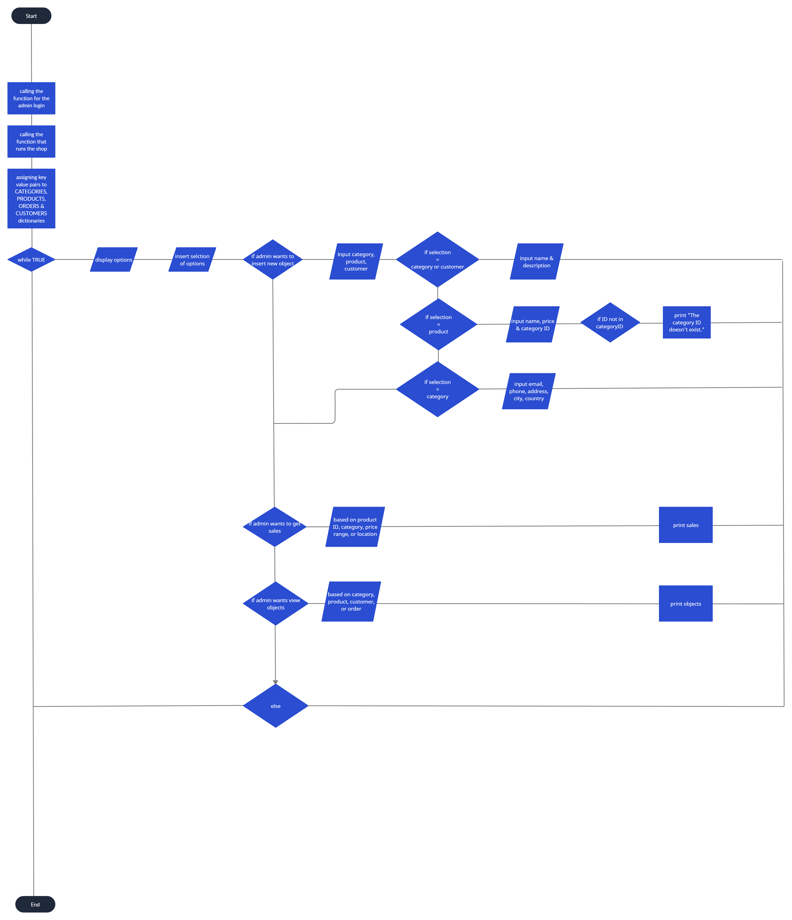
Flowchart

Slide 5
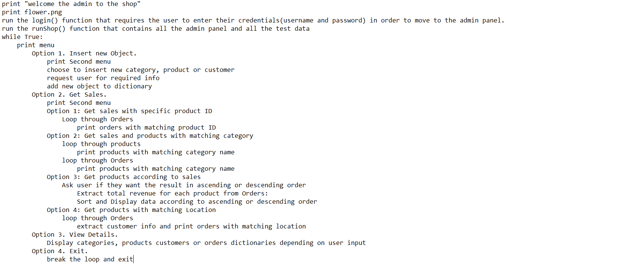
Pseudocode

Slide 6
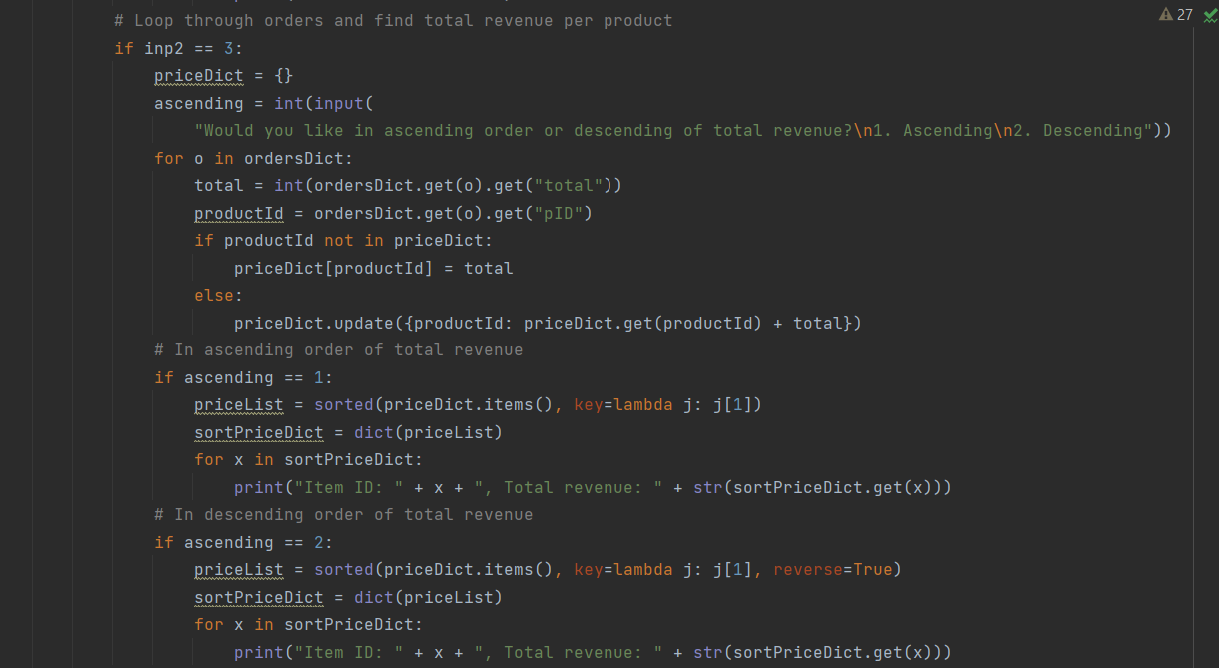
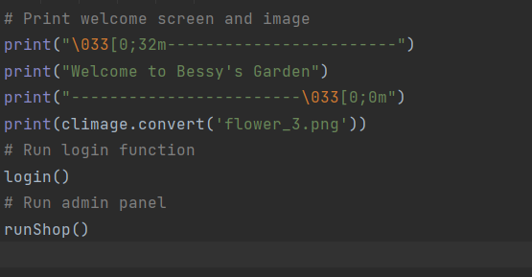
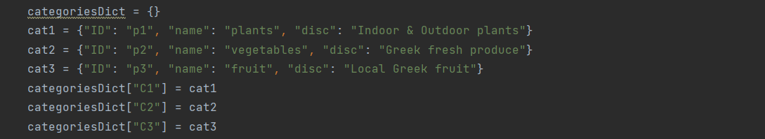
Code Snippets

Slide 7
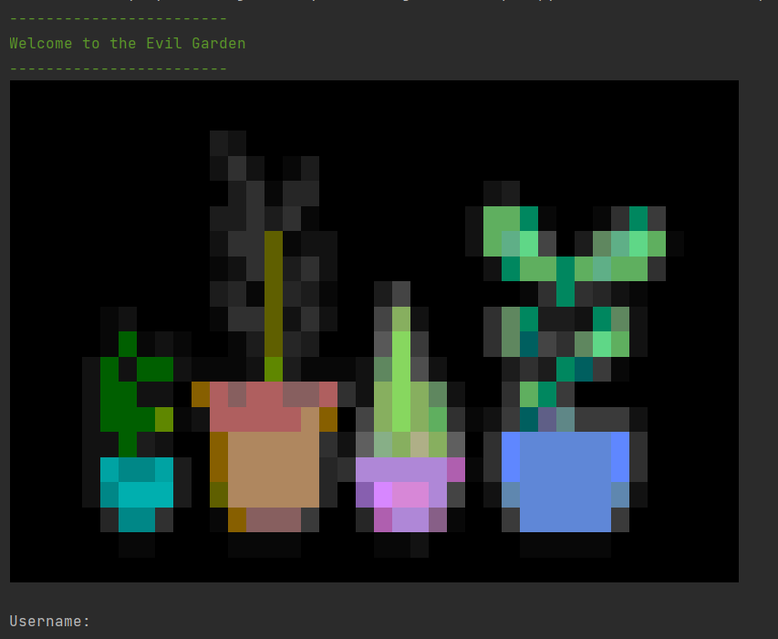
Outputs

Slide 8
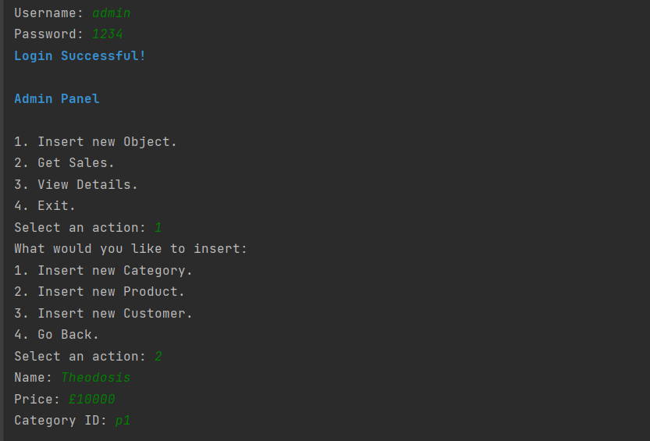
Outputs

Slide 9
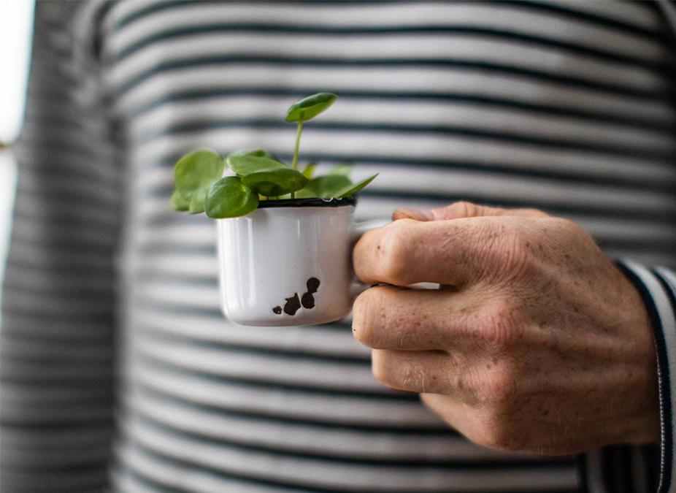

Thank you

